Slide 1
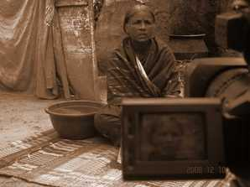
Seeing beyond the screen
Anita Gurumurthy
IT for Change
18 Dec 2018
Reflections on crafting technology
for the art of change

Slide 2
Prakriye field centre, Mysuru
The initial years: 2005 to 2010

Slide 3
Macro-context
2005, the year we started was also the
UN International Year of Microcredit
Mainstreaming of microcredit coincided with the instrumentalisation of women’s collectives or sanghas
Community content - grappling with production and distribution

Slide 4
Micro-context
Hunsur and H.D.Kote block of Mysore district, a socio-economically backward region with a high percentage of tribal and dalit population
Women’s collectives formed under numerous programmes led by governments and NGOs but losing their critical edge due to overemphasis on savings and credit
Casteist and feudal local politics and its stranglehold over public services

Slide 5
How to reclaim the spirit of sangha solidarity?

Slide 6

The connected local -- Kelu Sakhi

Slide 7
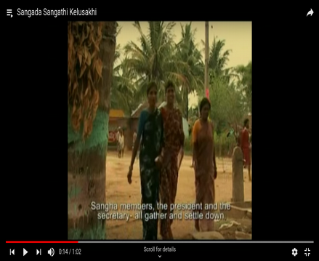

The connected local

Slide 8
Kelu Sakhi (contd.)
Characters: breaking stereotypes of caste, gender
Compere script situations: women as public actors
“When I listen to the radio, it is like in the early days when our sangha was new -- when just being together was enough, and that felt like a festival (habba)”
Counter-public -- “We speak as we are” (bringing dalit women’s dialect to the mainstream of the Open University radio channel)

Slide 9
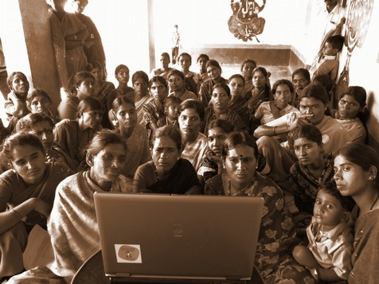
Screen as (the) public

Slide 10
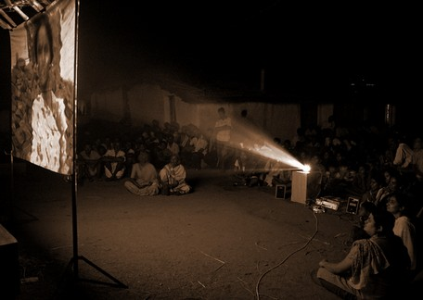
The Selfwe
Experience sharing
Halli to Dilli

Slide 11
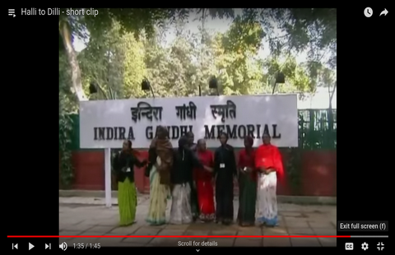
Halli to Dilli

Slide 12
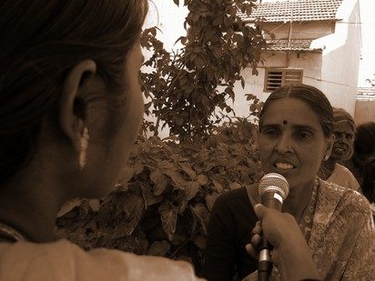
Politics of mutuality and co-implication, not passive consumption
“I see these videos because they are about women like us. They are not about the lives of people in Bengaluru or in other big cities. Till now, our voice was with us alone.. Now through the films, our voice travels far and wide.”
Namma Akkandira Nodi

Slide 13
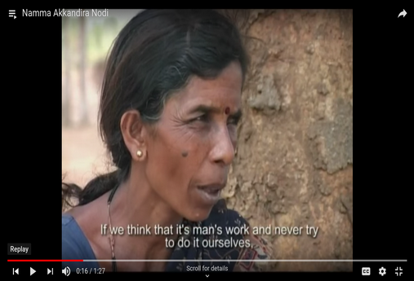
Namma Akkandira Nodi

Slide 14
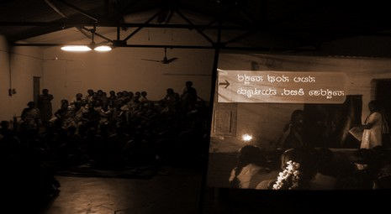
Conviviality - video as communification force

Slide 15
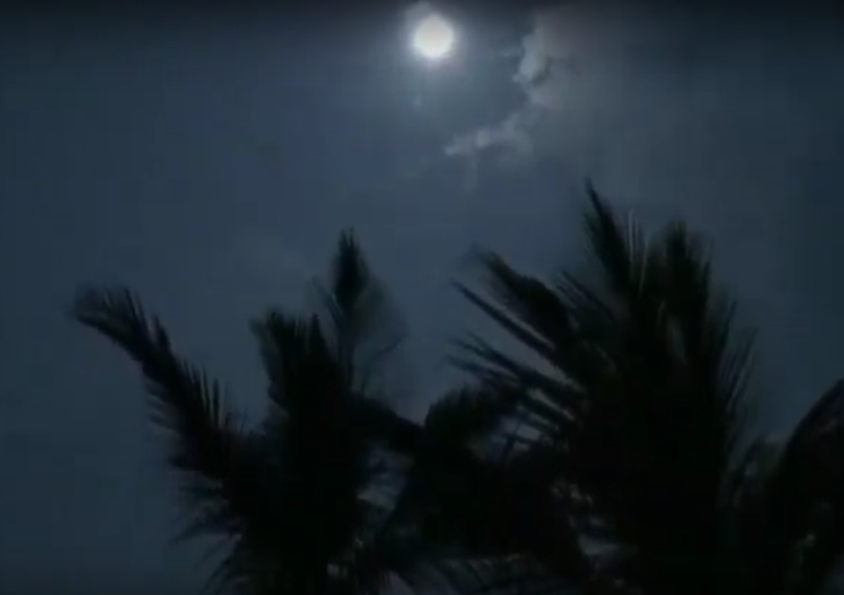

Slide 16
The middle years
2010-2013

Slide 17
Shifts in the macro-context
Gram Panchayat elections of 2010 -- more money coming into local bodies. Karnataka ranked second in the financial devolution index.
Union government pushes the pedal on digital service delivery, boosting the Common Service Centres programme and launching the citizen identity project (Aadhaar)
Decade of the mobile explosion -- from less than 3% in 1999, mobile phone penetration rate touches 70% in 2012
Wireless broadband outpaces the growth of wired broadband, though total Internet penetration is only about 10% of the population

Slide 18
Shifts in the micro-context
70 women leaders from sanghas had come to power in the Gram Panchayat elections. But after elections, their ties with the sanghas were lost. As one woman bluntly put it:
“ I got elected because my caste leaders and my husband spent seven lakhs on the campaign. I have to repay this favour and that has to be my focus. How can the sangha members complain that I am not paying attention to their interests?”
The rise and rise of “percentage raj” in sanctioning social welfare claims

Slide 19
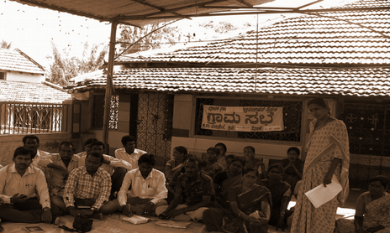
The screen as political

Slide 20
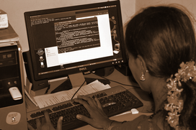
The heart of our new intervention ecosystem -
ICT-enabled information centres and a cadre of women informediaries from the grassroots

Slide 21
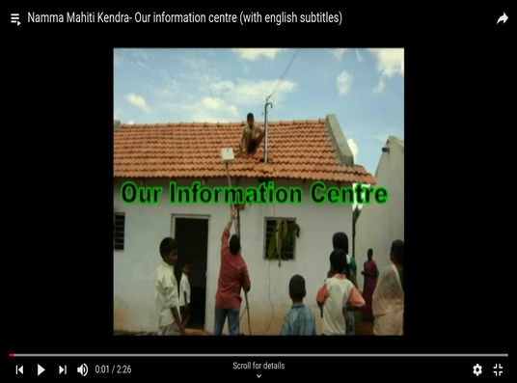
Namma Mahiti Kendra film

Slide 22
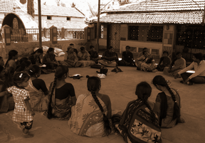
Beyond the smokescreen of local politics
The power of small data for claims-making
Village level beneficiary audits of widow pension and old age pension schemes
Negotiations with the Gram Panchayat / the case of the housing scheme audit

Slide 23
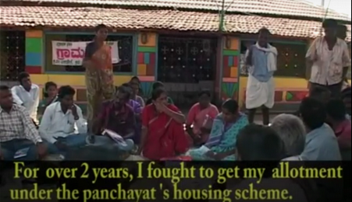
Negotiations with the Gram Panchayat

Slide 24
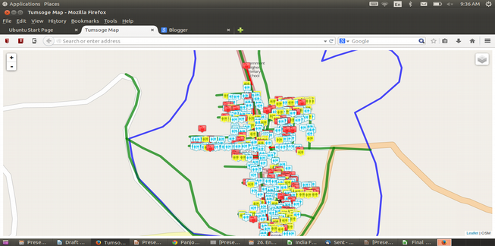
Making an unknown known a ‘known known’

Slide 25
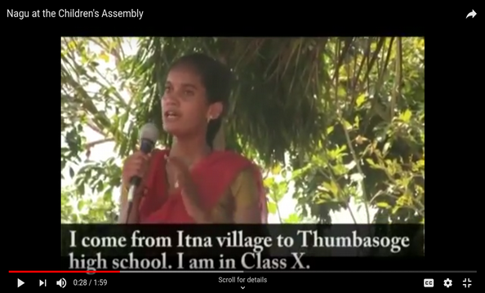
Nagu at the children’s assembly

Slide 26
The current context
2014 onwards

Slide 27
Shifts in the macro-context
Explosive growth of mobile broadband -- India now world’s fastest growing market for mobile apps. Gender divides persist - National Family Health Survey
Resurgence of caste pride and feudal patriarchy with urban modernity, and destabilisation of gender power structures.

Slide 28
Shifts in the micro-context
Women in operational area have shared access to basic feature phones; data still a scarce resource
The rise of “khap” - fines on girls breaking traditional gender norms
Exploitative lending practices of MFIs, local support networks wither away in the survival struggle, compounded by agrarian distress
What will happen to histories of solidarity? Can we pass them on to the next generation?

Slide 29
Rewiring public discourse
Anjali akka: Hey, this is Anjali akka again. Let’s now go and find out what Ramesha decided after he went for family counselling sessions at the Santwana Kendra.
Counselor’s voice: Why can’t you adopt a child? Does it make sense to abandon your wife just because she is childless?
Ramesha: I love my wife. We have been married for five years. I realise there is another way to address this situation. Let’s go home, Lakshmi (to his wife)
Lakshmi: It is good we sorted this out at the Santwana Kendra
Anjali akka: This is the way we should step in and help, if these things happen in our village
(Translated from a voice message)

Slide 30
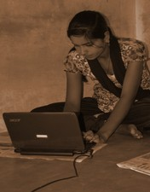
The screen as personal

Slide 31
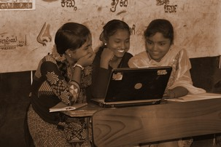
Emancipatory fictions

Slide 32
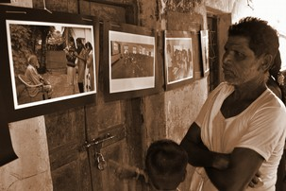
Negotiating patriarchies

Slide 33
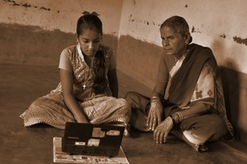
Intergenerational dialogues

Slide 34
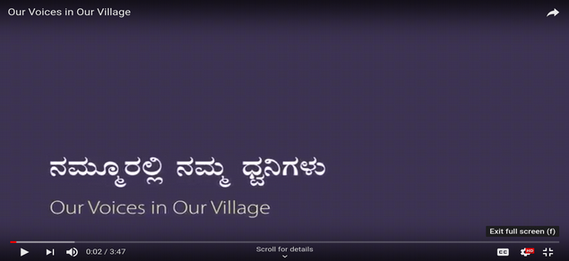
Emancipatory fictions

Slide 35
Challenges we negotiate
Agrarian crisis and collapse of the rural economy
The deep silence of domestic violence
Sociologies of anomie -- suicides, elopement
Local as vital site for formal politics, ‘governance by disconnection’ (panchayat computerisation)
Fragile solidarities
The tenacious grip of caste
Big screens and new screens - TV, whatsapp
New challenges on the algorithmic road - credit scoring, AI in agriculture and more

Slide 36
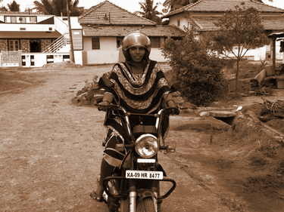

Slide 37
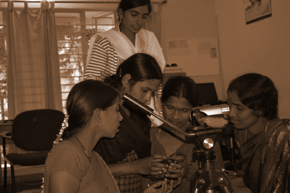
Sakhi as non-partisan steward of transformative change

Slide 38
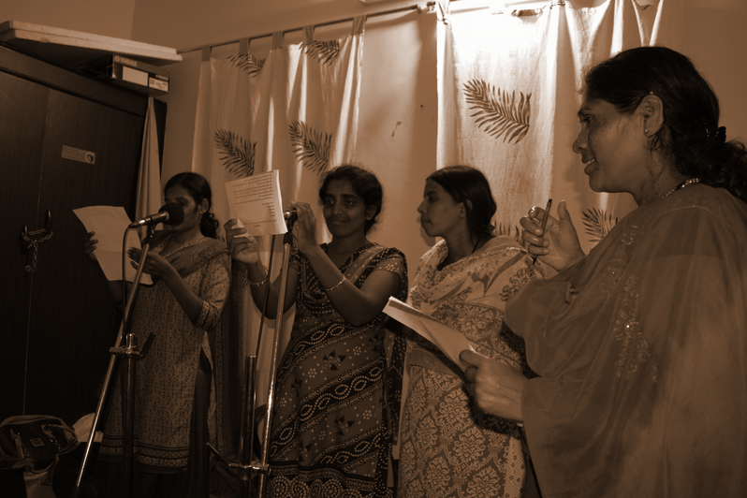

Slide 39
Community screenings has reached 10,000 people across 85 villages
IVR networks span 1000 subscribers across 60 villages
Radio broadcast comprised 500 episodes reaching out to 3 districts (Mysore, Mandya, Wayanad in Kerala)
Data costs - 10,000 INR per year for 14 connections, 1.5 GB per day limit plan
Digital infrastructure investments -- 846,000 INR for field centre; 400,000 INR across all 7 information centres

Slide 40
Where we are headed
Addressing hyper-masculinities
Help desks at first mile to tackle gender based violence
Understanding the anatomy of fintech

Slide 41
What does it mean to be an artizen?
New literacy in the age of code
Interrupting the dominant algorithmic condition - can alternative knowledge models legitimise invisible reality?
Humane engagement - trade-offs between competing values
Validating the need for belonging and recognition, just as much as aspiration
Data and technology as political performance

Slide 42
Thank you www.ITforChange.net

